Slide 1
Basic Concepts of Algorithm and Flowchart
Name : Rupak Sarkar Roll No.: 14271024036 Stream : MCA Semester : Semester 1st Subject : Programming Concept with Python Subject Code : MCAN-101

Slide 2
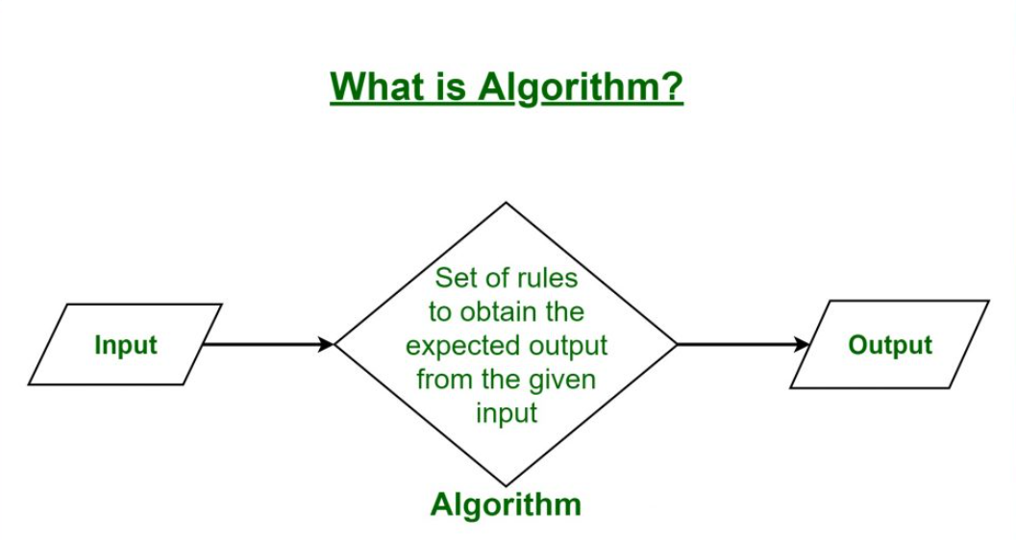
What is an Algorithm?
An Algorithm is a well-defined, step-by-step set of instructions or procedures designed to perform a specific task or solve a particular problem. Algorithms are foundational in computer science and mathematics but can be applied in various fields to process data, automate decision-making, and optimize processes.
Key Characteristics of an Algorithm:
Finiteness: It must terminate after a finite number of steps.
Definiteness: Each step must be clear and unambiguous.
Input: It may require zero or more inputs to operate.
Output: It should produce at least one output or result.
Effectiveness: Each step should be basic enough to be executed in a finite amount of time.

Slide 3
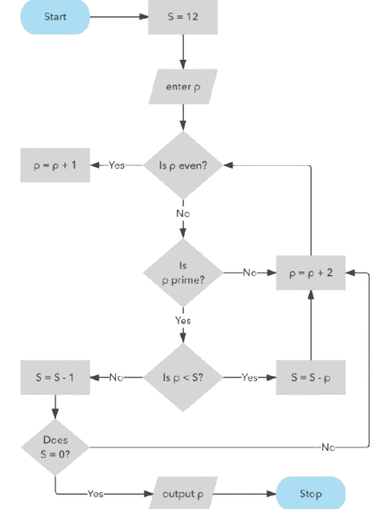
What is a Flowchart?
A Flowchart is a graphical representation of a process or algorithm, using symbols and arrows to depict the sequence of steps or actions required to solve a problem or complete a task. Flowcharts are widely used in various fields, including computer science, business, and engineering, to visualize workflows, algorithms, and decision-making processes.
Key Elements of a Flowchart:
Symbols: Standard shapes represent different types of actions or steps:
Oval: Start or end of a process.
Rectangle: Process or operation.
Diamond: Decision point.
Arrow: Direction or flow of steps.
Flow Lines: Arrows connect the symbols, indicating the flow or sequence.
Labels: Descriptive text inside symbols provides clarity about the steps.

Slide 4
Properties of Algorithm
1. Finiteness
The algorithm must always terminate after a finite number of steps.
This ensures the process does not run indefinitely and produces a result within a reasonable amount of time.
2. Definiteness
Each step in the algorithm must be clear, precise, and unambiguous.
3. Input
An algorithm can accept zero or more inputs to operate.
These inputs are provided to the algorithm before it begins or during its execution.
4. Output
An algorithm must produce at least one output or result.
The output is the solution or final state after processing the input.
5. Effectiveness
Each operation in the algorithm must be simple enough to be performed within a finite amount of time and with finite resources.
6. Generality
An algorithm should be general enough to solve a class of problems, not just a specific instance.

Slide 5

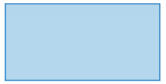

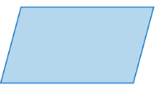

Symbols of Flowchart
Start/End: The terminator symbol marks the start and end of the flowchart.
Process: This symbol is used to denote processes in the flowchart.
Decision: This symbol is used to make decisions in the flowchart.
Input/Output: Represents material or information entering or leaving
the system.
Merge: Indicates a step where two or more sub-lists become one.

Slide 6
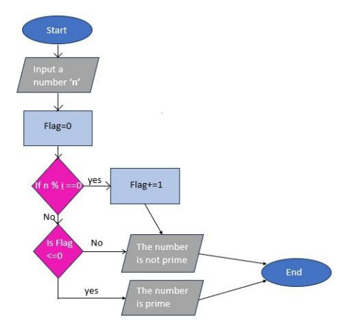
DRAW A FLOWCHART AND WRITE ITS CORRESPONDING ALGORITHM TO FIND WHETHER A NUMBER IS PRIME OR NOT.
Algorithm Flowchart
1. Start
2. Input: Read a number n from the user.
3. Initialize: Set flag to 0.
4. Check divisors: Loop from i = 2 to n.
If n % i == 0 (i.e., n is divisible by i):
Set flag = 1. - Break the loop.
5. Decision: Check the value of flag.
- If flag == 0:
- Print "The number is Prime."
Else: -
Print "The number is not Prime."
6. End

Slide 7
Thank You!

